Slide 1
INTERNATIONAL POLICY AND DIPLOMACY OF KAZAKHSTAN
Lecture 2
al Farabi Kazakh National University
Department of Philosophy and Political Science
Chair of Political Science and Political Technologies
By Marem Buzurtanova

Slide 2
INTERNATIONAL POLICY AND DIPLOMACY OF KAZAKHSTAN Lecture 2
LECTURE 2. NATIONAL INTERESTS, FOREIGN POLICY AND DIPLOMACY
Topics to Be Covered:
• Relations between international relations and world politics;
• Relations between sovereignty, statehood and international relations;
• Relations between national interests and foreign policy;
• Relations between foreign policy and diplomacy.

Slide 3
INTERNATIONAL POLICY AND DIPLOMACY OF KAZAKHSTAN Lecture 2
Relations between international relations and world politics

Slide 4
INTERNATIONAL POLICY AND DIPLOMACY OF KAZAKHSTAN Lecture 2
international Relations | world politics
The relations of states with each other and with international organizations and certain subnational entities (e.g., bureaucracies, political parties, and interest groups). The relations of international actors that transcend national borders and jurisdictions. A system of political, economic, ideological, legal, diplomatic, military, cultural and other ties and relationships between actors operating in the international arena. The social relations that go beyond intra-social relations and territorial entities. Political relations of nation states. | The political and economic patterns of the world.

Slide 5
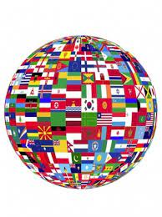
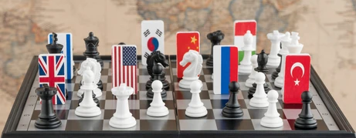
INTERNATIONAL POLICY AND DIPLOMACY OF KAZAKHSTAN Lecture 2
International relations | World politics
What ? | How?

Slide 6
INTERNATIONAL POLICY AND DIPLOMACY OF KAZAKHSTAN Lecture 2
Relations between sovereignty, statehood and international relations

Slide 7
INTERNATIONAL POLICY AND DIPLOMACY OF KAZAKHSTAN Lecture 2
Montevideo Convention on the Rights and Duties of States
Done at: Montevideo, In force: 1934-12-26
Article 1
The state as a person of international law should possess the following qualifications: a permanent population; defined territory; government; and capacity to enter into relations with the other states.
Article 2
The federal state shall constitute a sole person in the eyes of international law.
Article 3
The political existence of the state is independent of recognition by the other states. Even before recognition the state has the right to defend its integrity and independence, to provide for its conservation and prosperity, and consequently to organize itself as it sees fit, to legislate upon its interests, administer its services, and to define the jurisdiction and competence of its courts. The exercise of these rights has no other limitation than the exercise of the rights of other states according to international law.
Article 4
States are juridically equal, enjoy the same rights, and have equal capacity in their exercise. The rights of each one do not depend upon the power which it possesses to assure its exercise, but upon the simple fact of its existence as a person under international law.

Slide 8
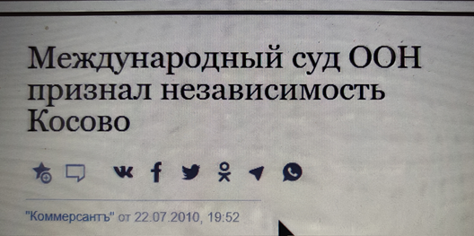
INTERNATIONAL POLICY AND DIPLOMACY OF KAZAKHSTAN Lecture 2
Recognition of states and governments (1)
Recognition of states – examples:
Iran and Israel
Taiwan and the PRC
Kosovo and Serbia
Abkhazia and South Ossetia
When two states are the parties to a multilateral international treaty, does it mean official recognition of each other’s statehood? Does it mean tacit recognition?
What is wrong with this headline?

Slide 9
INTERNATIONAL POLICY AND DIPLOMACY OF KAZAKHSTAN Lecture 2
Sovereignty - authority, in the decision-making process of the state and in the maintenance of order.
The concept of sovereignty—one of the most controversial ideas in political science and international law—is closely related to the difficult concepts of state and government and of independence and democracy.
Originally understood to mean the equivalent of supreme power, but has departed from this traditional meaning…

Slide 10
INTERNATIONAL POLICY AND DIPLOMACY OF KAZAKHSTAN Lecture 2
History
Jean Bodin (1530–96): the power of the French king over the rebellious feudal lords;
Thomas Hobbes (1588–1679): in every true state some person or body of persons must have the ultimate and absolute authority;
John Locke (1632–1704) and Jean-Jacques Rousseau (1712–78): state is a formal or informal social compact, which is the basis for its sovereignty;
John Austin (1790–1859) sovereignty is vested in a nation’s parliament who exercises it in the name of the people or of the state.

Slide 11
INTERNATIONAL POLICY AND DIPLOMACY OF KAZAKHSTAN Lecture 2
The Peace of Westphalia as the beginning of the modern international system established the principle of non-interference.
The UN Charter prohibits the threat or use of force and calls on all Members to respect the sovereignty, territorial integrity and political independence, The Organization is based on the principle of the sovereign equality of all its Members (Article 2). moreover it states that “nothing ... shall authorize the United Nations to intervene in matters which are essentially within the domestic jurisdiction of any state…”
but
the powers of security Council and R2P

Slide 12
INTERNATIONAL POLICY AND DIPLOMACY OF KAZAKHSTAN Lecture 2
Over to you!
Relations between national interests and foreign policy

Slide 13
INTERNATIONAL POLICY AND DIPLOMACY OF KAZAKHSTAN Lecture 2
Relations between foreign policy and diplomacy

Slide 14
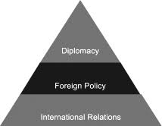
INTERNATIONAL POLICY AND DIPLOMACY OF KAZAKHSTAN Lecture 2

Slide 15
INTERNATIONAL POLICY AND DIPLOMACY OF KAZAKHSTAN Lecture 2
National interests – international relations
Foreign policy – set of actions aimed at achieving certain goals
Diplomacy – influence (change/prevent change) the policies and actions of states and other international actors …
Bilateral relations
to achieve/promote the goals of foreign policy in accordance with the national interests
Multilateral regimes

Slide 16
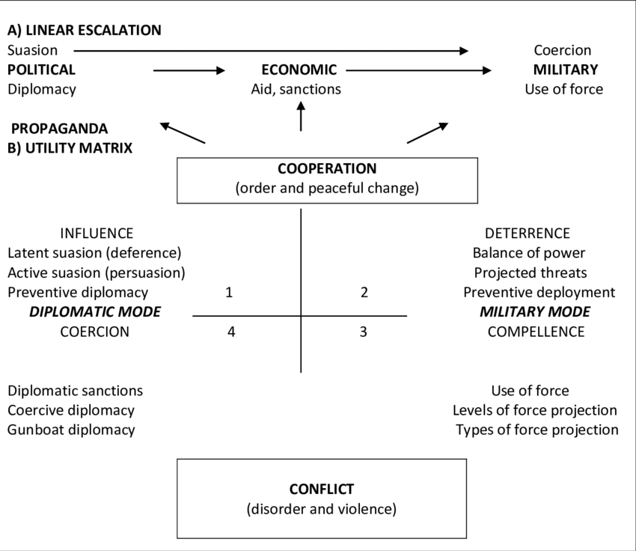

Slide 17
INTERNATIONAL POLICY AND DIPLOMACY OF KAZAKHSTAN Lecture 2
Vienna convention on the law of treaties ARTICLE 7 FULL POWERS
1. A PERSON IS CONSIDERED AS REPRESENTING A STATE FOR THE PURPOSE OF ADOPTING OR AUTHENTICATING THE
TEXT OF A TREATY OR FOR THE PURPOSE OF EXPRESSING THE CONSENT OF THE STATE TO BE BOUND BY A TREATY IF:
(A) HE PRODUCES APPROPRIATE FULL POWERS; OR
(B) IT APPEARS FROM THE PRACTICE OF THE STATES CONCERNED OR FROM OTHER CIRCUMSTANCES THAT THEIR
INTENTION WAS TO CONSIDER THAT PERSON AS REPRESENTING THE STATE FOR SUCH PURPOSES AND TO DISPENSE WITH FULL POWERS.
2. IN VIRTUE OF THEIR FUNCTIONS AND WITHOUT HAVING TO PRODUCE FULL POWERS, THE FOLLOWING ARE
CONSIDERED AS REPRESENTING THEIR STATE:
(A) HEADS OF STATE, HEADS OF GOVERNMENT AND MINISTERS FOR FOREIGN AFFAIRS, FOR THE PURPOSE OF PERFORMING ALL ACTS RELATING TO THE CONCLUSION OF A TREATY;
(B) HEADS OF DIPLOMATIC MISSIONS, FOR THE PURPOSE OF ADOPTING THE TEXT OF A TREATY BETWEEN THE ACCREDITING STATE AND THE STATE TO WHICH THEY ARE ACCREDITED;
(C) REPRESENTATIVES ACCREDITED BY STATES TO AN INTERNATIONAL CONFERENCE OR TO AN INTERNATIONAL ORGANIZATION OR ONE OF ITS ORGANS, FOR THE PURPOSE OF ADOPTING THE TEXT OF A TREATY IN THAT CONFERENCE, ORGANIZATION OR ORGAN.

Slide 18
INTERNATIONAL POLICY AND DIPLOMACY OF KAZAKHSTAN Lecture 2
Self-Check Questions:
How do international relations and world politics similar or differ from each other?
How sovereignty and statehood influence the capacity to conduct international relations? What is the recognition of states and government? How does it matter?
What are the relations between national interests and foreign policy?
What are the relations between foreign policy and diplomacy?

Slide 19
INTERNATIONAL POLICY AND DIPLOMACY OF KAZAKHSTAN Lecture 2
Topical Readers Available at UNIVER System:
Hocking, B. (2020). Communication and Diplomacy: Change and Continuity. In Global Diplomacy (pp. 79-96). Palgrave Macmillan, Cham.
Qin, Y. (2020). Diplomacy as relational practice. The Hague Journal of Diplomacy, 15(1-2), 165-173.
ONYEAKU, C. (2020). Diplomatic Law and Practice of Diplomacy in a New Global Environment. IRLJ, 2(3).
Unoki, K. (2019). Competition Laws, National Interests and International Relations. Routledge.
Morin, J. F., & Paquin, J. (2018). Foreign policy analysis: A toolbox. Springer.
Neack, L. (2018). Studying Foreign Policy Comparatively: Cases and Analysis. Rowman & Littlefield.
Iucu, O. (2010). Diplomacy and diplomatic functions. Manager, (11), 129-134.
Mintz, A., & DeRouen Jr, K. (2010). Understanding foreign policy decision making. Cambridge University Press.
Sharp, P. (2009). Diplomatic theory of international relations (Vol. 111). Cambridge University Press.
Breuning, M. (2007). Foreign policy analysis: A comparative introduction. Springer.
Feltham, R. (2004). Diplomatic handbook. Martinus Nijhoff Publishers.
Nazarbayev, N. A. (2007). New Kazakhstan in the new world. Kazakhstanskaya pravda, (33), 25278.
Tokayev, K. K. (2000). Foreign policy of Kazakhstan in the conditions of globalization. Almaty, Kazakhstan.
Vanderhill, R., Joireman, S. F., & Tulepbayeva, R. (2020). Between the bear and the dragon: multivectorism in Kazakhstan as a model strategy for secondary powers. International Affairs, 96(4), 975-993.
Diyarbakırlıoğlu, K., & Yiğit, S. (2014). Kazakh Multi Vector Foreign Policy in Action. Alternatives: Turkish Journal of International Relations, 13(4).

